Slide 1


Notes Sharing Web Application
Submitted by
Tahira Begum.S
720921104108
JCT College of Engineering & Technology -Coimbatore

Slide 2
OUTLINE
Introduction to a Notes Sharing Application
Key Features
User Interface
Use Cases
Conclusion

Slide 3
Introduction to a Notes Sharing Web Application
In the digital age, the need for efficient and convenient ways to share information is paramount. A Notes Sharing Web Application serves as a digital platform designed to facilitate the creation, organization, and sharing of notes among users. Whether it's for educational purposes, professional collaboration, or personal organization, such a platform offers numerous benefits and conveniences
Importance:
The importance of a Notes Sharing Web Application lies in its ability to facilitate seamless collaboration, streamline information sharing, and promote organization and productivity.This technology empowers users to access their notes anytime, anywhere, fostering flexibility and accessibility. Overall, a Notes Sharing Web Application is a valuable tool for optimizing efficiency and maximizing the impact of shared knowledge and ideas

Slide 4




Key Features
User-Friendly Interface
Search Functionality
Access Control and Privacy
Admin Panel
The application provides an intuitive interface for users to easily create, edit, and organize their notes. It should be accessible across various devices and operating systems.
A robust search feature enables users to quickly find relevant notes based on keywords or tags, even within large collections of notes
Users have control over the visibility and accessibility of their notes. They can set permissions to determine who can view, edit, or comment on their content, ensuring privacy and security.
The admin panel for adding notes in a Notes Sharing Web Application offers administrators the ability to create, edit, and manage notes on behalf of users

Slide 5
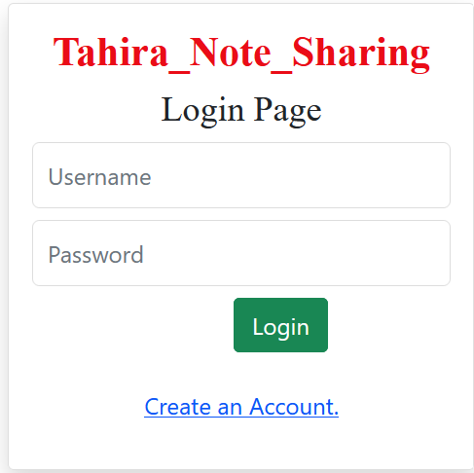
Login Page

Slide 6
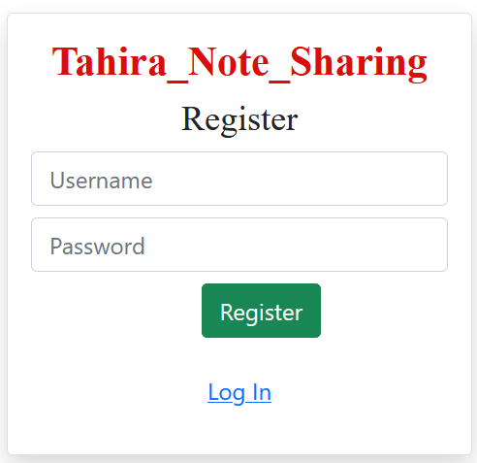

Slide 7
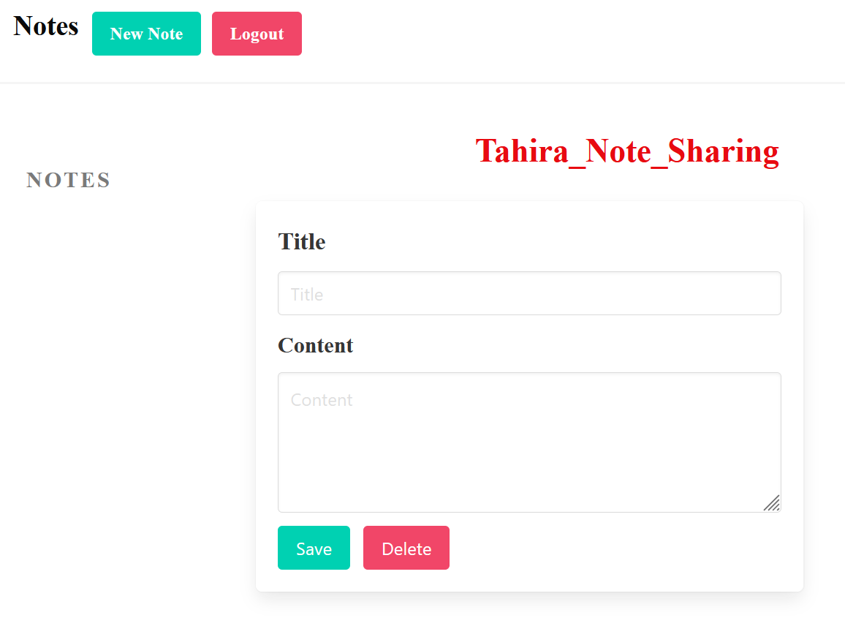

Slide 8
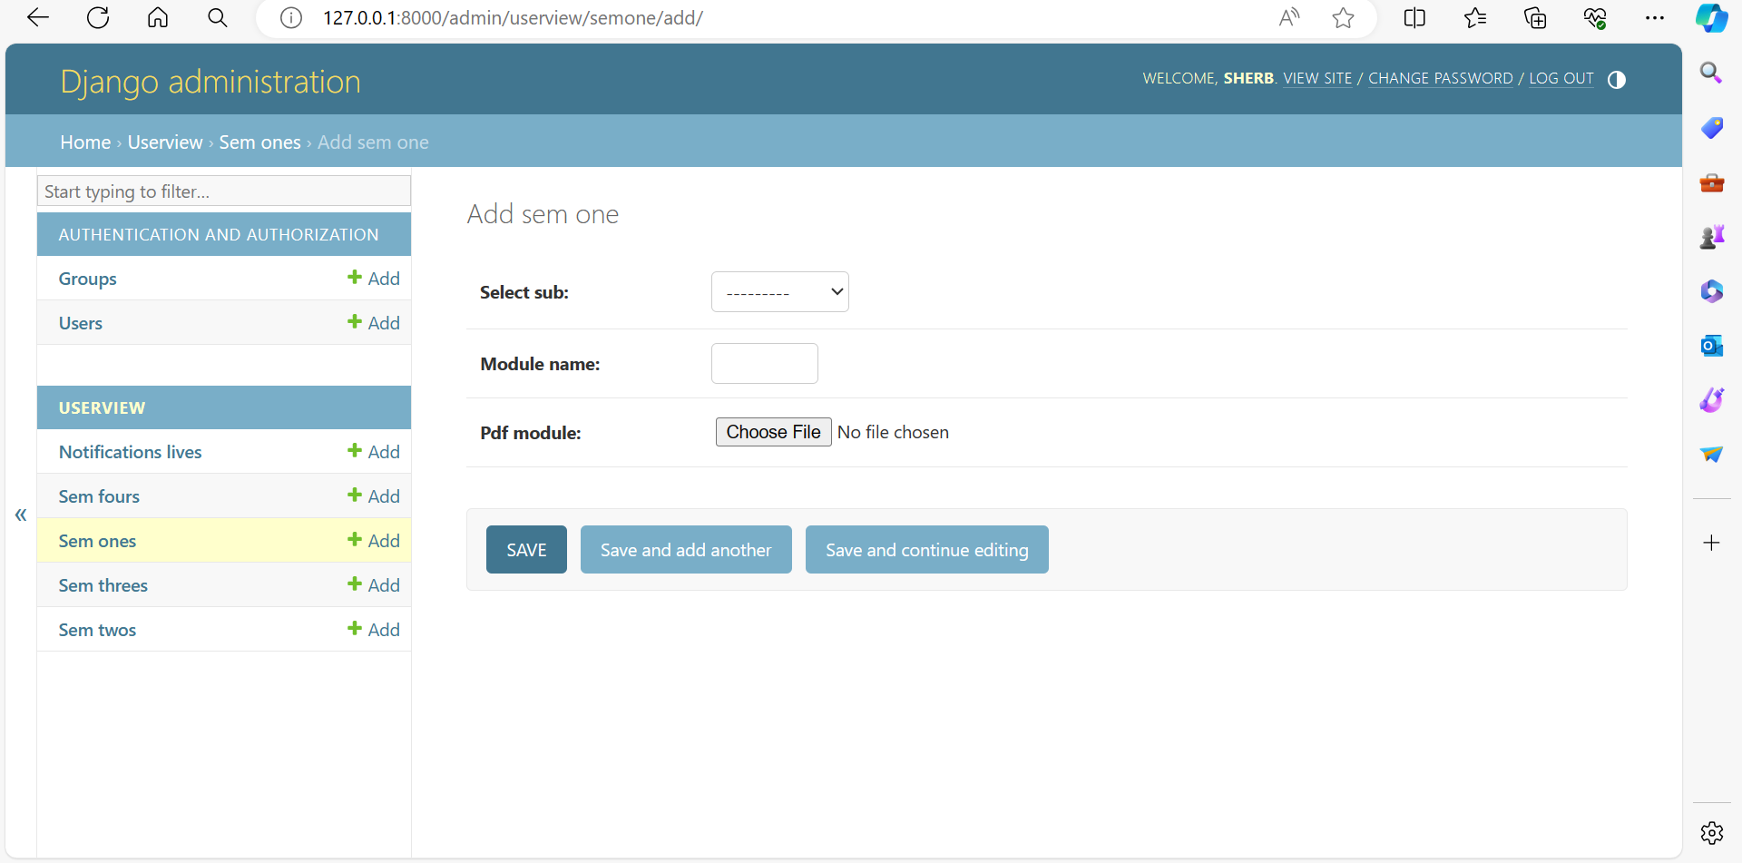

Slide 9
Use Cases
Educational Collaboration: Students can use note sharing web applications to collaborate on study materials, lecture notes, and project research. They can create shared study guides, exchange insights, and collectively build knowledge resources.
Remote Learning and Teaching: With the rise of remote learning, note sharing web applications provide a platform for educators to share course materials, assignments, and resources with students. They can create lecture notes, share reading materials, and facilitate discussions in virtual classrooms.
Research and Academic Publishing: Researchers and academics can use note sharing applications to share findings, collaborate on papers, and contribute to scholarly discussions. They can share research notes, collaborate on manuscripts, and provide feedback to peers in their field.

Slide 10

Conclusion
In conclusion, note sharing applications serve as versatile tools that facilitate collaboration, knowledge exchange, and organization across various domains. Whether utilized for educational purposes, professional endeavors, or personal organization, these platforms offer a centralized hub for users to create, share, and collaborate on notes. By promoting efficient communication, enhancing productivity, and fostering learning and growth, note sharing applications play a crucial role in empowering individuals, teams, and communities to connect, collaborate, and succeed in today's digital age. As technology continues to evolve, the significance and impact of note sharing applications are expected to grow, providing invaluable support for collaboration and knowledge sharing in diverse contexts.

Slide 11
Thank you

